Slide 1

Zero Knowledge Proofs for Authenticated and
Secure Communication
MTech (CSE)
Session 2024-25
Submitted By: Ritesh Gupta (MT24132)
Bhargav Jani (MT24115)
Under the guidance of:
Dr. Ravi Anand
Assistant Professor, Department of CSE,IIITD
Indraprastha Institute of Information Technology New Delhi

Slide 2
INTRODUCTION
Definition and Purpose:
Zero Knowledge Proofs (ZKP) are cryptographic methods that enable one party to prove a fact to another without revealing extra information.
They ensure privacy by disclosing only the validity of the statement, nothing more.
ZKPs are crucial for secure authentication and data protection in modern communication systems.

Slide 3
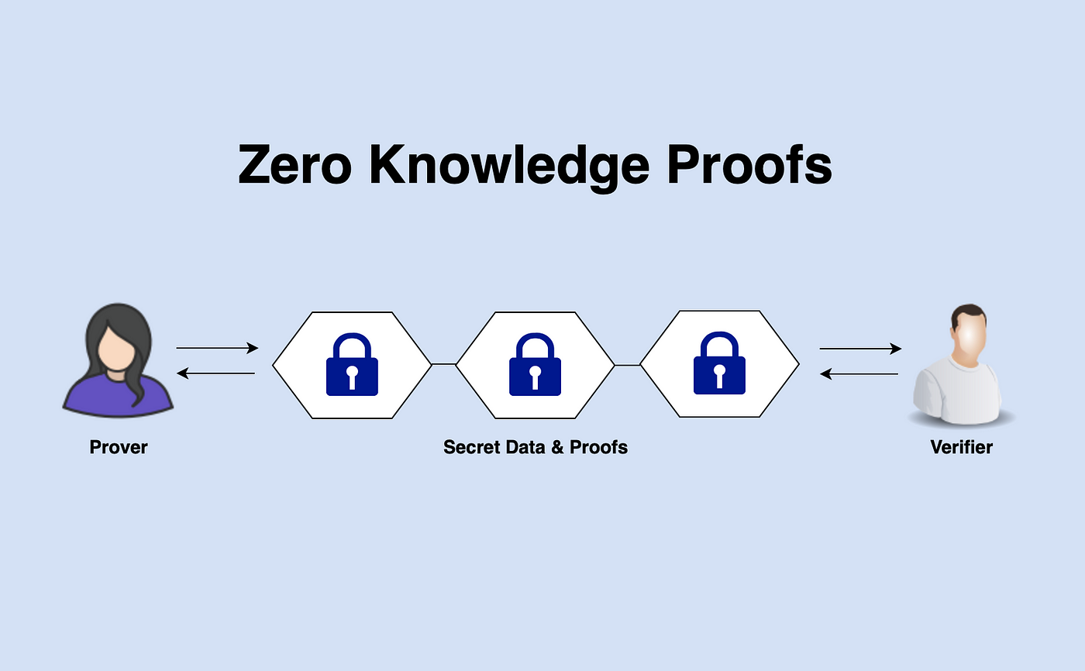

Slide 4
Project Objective
Investigate the effectiveness of Zero Knowledge Proofs in enhancing privacy during authentication processes.
Evaluate the scalability of ZKPs in real-world communication networks for secure data exchange.
Explore the integration of ZKPs with blockchain technology for decentralized secure communications.
Assess the performance of Zero Knowledge Proofs in reducing the risk of data leaks and unauthorized access.

Slide 5
Problem Statement
Ensuring secure authentication without compromising user privacy remains a significant challenge in modern communication systems.
Traditional cryptographic methods often expose sensitive information during the authentication process, risking data breaches.
Current protocols lack efficient, privacy-preserving solutions for secure communication in decentralized networks.

Slide 6
Proposed Work
Implement HMAC-based encryption and decryption for secure message communication.
Use SHA3-256 (or other hashing algorithms) for generating HMAC digests to ensure robust security.
Enable encryption and decryption of messages in chunks for efficient processing and handling.
Generate a decryption dictionary containing all possible combinations of characters for efficient lookup
Utilize secure random number generation for enhancing the security of the HMAC key and message handling.
Ensure compatibility with multiple hashing algorithms, allowing flexibility for different security requirements.
Create a reliable decryption mechanism that allows for the retrieval of original messages from encrypted chunks.
Integrate utility functions for smooth type conversion between strings and bytes to facilitate encryption/decryption operations.

Slide 7
System Design:
1. HMAC Client Initialization:
Algorithm Selection
Secret Key Setup
Symbol Count Configuration
Decryption Dictionary Setup
2. Message Encryption:
Chunking of Message
HMAC Generation for Each Chunk
Secure Conversion to Bytes
Message Encryption Output

Slide 8
Contd…
3. Message Decryption:
Chunk Alignment Validation
Lookup in Decryption Dictionary
Error Handling for Invalid Chunks
Message Reconstruction
4. Secure Randomization:
Random Key Generation
Secure Random Generation for Chunking

Slide 9
Contd…
5. Utility Functions:
String-to-Bytes Conversion
Bytes-to-String Conversion
6. Performance and Security Testing:
Testing with Different Hashing Algorithms
Decryption Accuracy Verification
Security Auditing for Key and Message Integrity

Slide 10
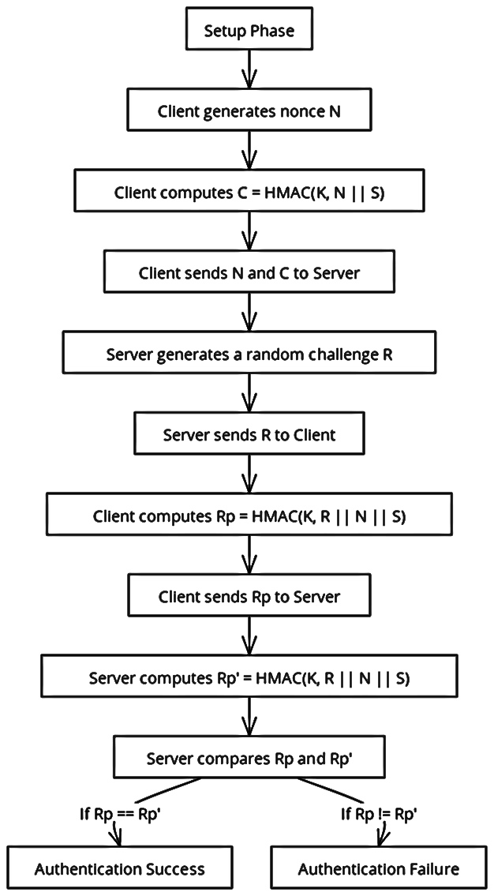
Figure: Work Flow Diagram

Slide 11
Conclusion
Enhanced Privacy Protection
Secure Authentication Mechanism
Efficient Communication Protocol
Resilient Against Attacks

Slide 12
Limitations
Computational Overhead
Scalability Challenges
Complex Implementation
Limited Standardization
Future Scopes:
Improved Efficiency
Wider Adoption
Integration with Iot
Quantum Resistance

Slide 13
THANK YOU

